Slide 1
Network economics: the hardware/software paradigm, winner-takes-all-markets and technological standard wars_2
Luca Grilli
L. Grilli, Politecnico di Milano –Network economics

Slide 2
Innovation in a network market: the start-up problem

Slide 3
The demand for a network good
Respect to the standard demand curve, the demand for a network good does not only depend on price but also on the agents’ expectations about total consumers of the good.
Some basic (and key) implications

Slide 4
Everybody in the economy is convinced that no body will buy the network good: the network good will be effectively unsold (very pessimistic expectations) irrespective of a high or low price: “network failure”.
Consumers want to buy a hardware if many softwares are available for that hardware. But software developers will write softwares only if a great number of people has already bought the hardware since they are potential buyers: if nobody makes the first move the network good will be effectively unsold (again irrespective of a high or low price): “network failure”
Chicken-egg paradox equilibria
(note how these markets are characterized to a great extent by “self-fulfilling prophecies”)

Slide 5
The aggregate demand could be upward sloping (Rolfhs 1974, BJE):
If a firm is able to influence the expectations of potential consumers about the penetration that the good will have (and so its value in the future), is totally plausible that as the expected size of the network increases, consumers are willling to pay a higher price for joining the network.
STANDARD
NETWORK
P
q

Slide 6
Demand presents a critical mass effect (Rolfhs 1974, BJE):
Critical mass in nuclear engineering
Under radioactive decay conditions, the amount of uranium necessary to start a self-sustaining process of production of neutrons that maintains unchanged its quantity. Any larger amount of uranium will cause an explosive nuclear chain reaction. Any smaller amount of uranium will cause nothing, and it will soon decompose.

Slide 7

Critical mass in sociology
https://www.youtube.com/watch?v=r0Ls24Fbl0g
Example from Schelling (1978):
Micromotives and Macrobehaviour
See also the “Dying Seminar” (self-explanatory) example provided in the Appendix 1 of these slides

Slide 8
Demand presents a critical mass effect (Rolfhs 1974, BJEM):
Critical mass in network economics
For any given price charged by the firm(s) it is the minimal amount of consumers which join the network and are satisfied of this choice. Any larger amount will trigger the bandwagon effect, any smaller amount will bring to a network failure.

Slide 9
STYLIZED EXAMPLE in network economics
Firm A has invented (and potentially patented) a network good (exhibiting direct externalities) and is going to commercialize it under a monopolistic regime.
Trade-off
High price and a high number of people to convince
Low price and a small number of people to convince
Suppose:
p = 100 €; at that price one may be willing to buy the good if it can be enable to communicate with (say) 1.000.000 people.
p = 1€; at that price a representative agent may be willing to buy the good if it can be enable to communicate with (say) 100 people.

Slide 10
If the choice of the firm is p = 1, the firm has to convince 100 people
If the choice of the firm is p =100, it has to convince 1.000.000 people
Whatever the choice, if the firm wants to sell the good it has to attract the critical mass (which is increasing in price).
If p =1€ but the firm convinces only 99 individuals, someone of these individuals will be unhappy (someone who gives to the good a value of 1€ only if 100 individuals had joined the network); so he will leave; the network size will shrink to 98 individuals, again someone of these individuals……
If p =1€ but the firm convinces more than 100 individuals, e.g. 101, the value of the network good raises, and some more agents will want to buy the network good, network size becomes 102, so the value of the good raises………..
AIM: Attract Critical Mass so to innescate the BANDWAGON EFFECT

Slide 11
Aggregate demand for a network good: a stylized model (Rohlfs 1974, Bell J of Econ and Man; see also Shapiro and Varian 1999)
Consider a network that is of interest for N potential agents. They are indexed by x which is uniformly distributed on the interval [0,1].
Each agent faces the binary decision of whether to buy the good or not. The good exhibits positive network externalities
If she buys
U = 0
If she doesn’t buy

Slide 12
Since a continuum of potential consumers exists in the interval [0,1], there will be therefore a particular consumer, indexed by x*, such that she is indifferent between buying and not buying the good. This consumer is found by:
Or :
Hence all the consumers that are indexed with an higher a-priori enthusiasm for the service (x ≤ x*) will buy the good, while all the others (x > x*) won’t.

Slide 13
(Remember self-fulfilling prophecies)
Perfect foresight is assumed
…and then the inverse aggregate demand curve for a network good becomes
2 stable equilibria:
Network of zero size (“network failure” caused by pessimistic expectations)
Network of large size (CRITICAL MASS is reached and positive feedback is triggered)
Critical mass: for any given price, it is the minimal amount of consumers which join the network and are satisfied of this choice

Slide 14
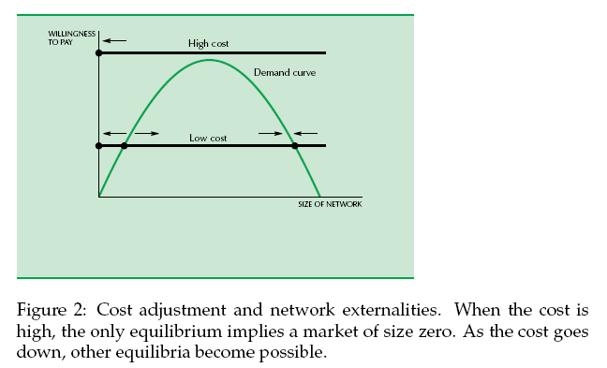
MARKET DYNAMICS (Shapiro & Varian 1999)
“[…]It is plausible to assume that when people are willing to pay more than the cost of the good, the size of the market expands and, when they are willing to pay less, the market contracts. Geometrically this is saying that when the demand curve is above the supply curve, the quantity goes up and, when it is beneath the supply curve, the quantity goes down.”

Slide 15
Typical path of a network good in a dynamic framework:
X = % users (penetration rate)
100%
Critical mass
Xm
Xl
time
1° phase: launch (0 – Xl); 2° phase: rapid growth (positive feedback, Xl - Xm); 3° phase: maturity (universal service policies, Xm – 100%).
Examples in the Appendix 2: starting from a failure (fixed videophone), passing through troubled expansion (fax and fixed telephone); and coming to a very rapid growth (most of the successful social media). The same pattern applies to goods with direct NE (those above) and goods with indirect NE (CDs, VCRs).

Slide 16
Comparison with the diffusion path of a «standard» innovation
%
Standard Good
Network Good
t
Start-up
Growth
Maturity

Slide 17
How to solve the start-up problem?
STRATEGIC POLICIES
Compatibility with competitors: share the effort but be careful since interlinking can generate a free-riding problem
Promotional prices (very often below costs)
Advertising (size and nature) https://www.youtube.com/watch?v=M5fNInc9OoE
https://www.youtube.com/watch?v=jhhyivR-SrY

Slide 18
FURTHER REMARKs ON THE POSSIBLE NON-EMERGENCE OF “WINNER TAKES ALL (or MOST)” MARKET EQUILIBRIA

Slide 19
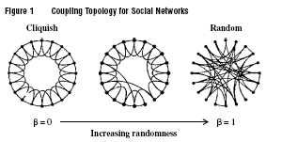
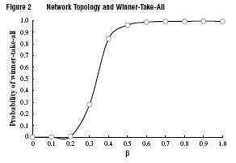
FROM Lee et al. (2006), Management Science
community of interest [Rohlfs 2003]

Slide 20

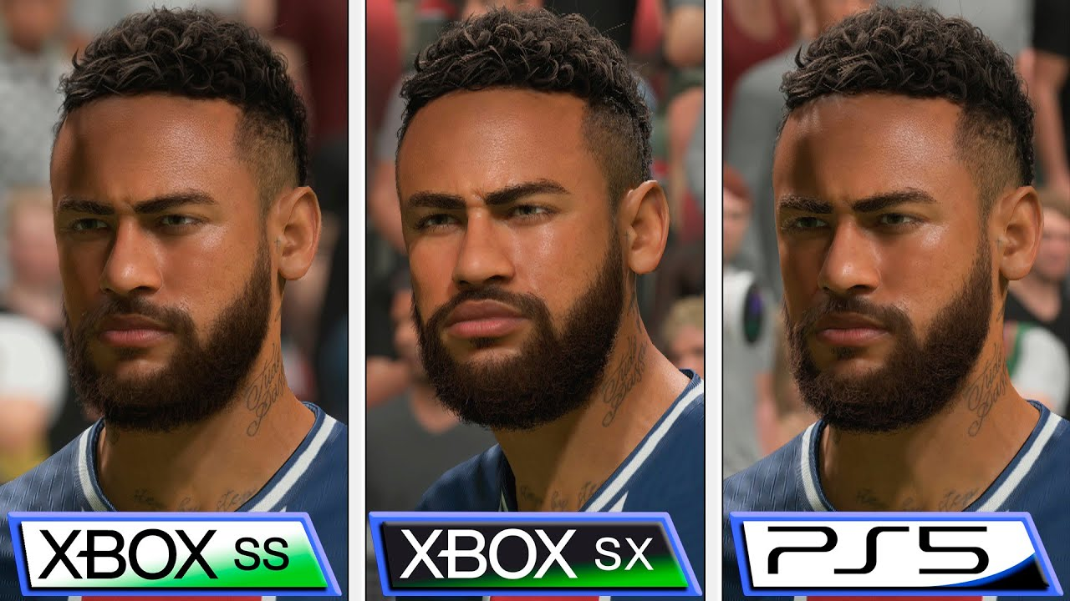
Multi-homing (on both consumers’ and producers’ sides)
Rysman (2009, JEP, p. 134): “[….]fixed cost of producing a video game for one more standard have reduced over time relative to the overall fixed costs of producing a game, which has led to increased distribution of games across multiple game systems (for example, PlayStation, Nintendo, and Xbox).”

Slide 21
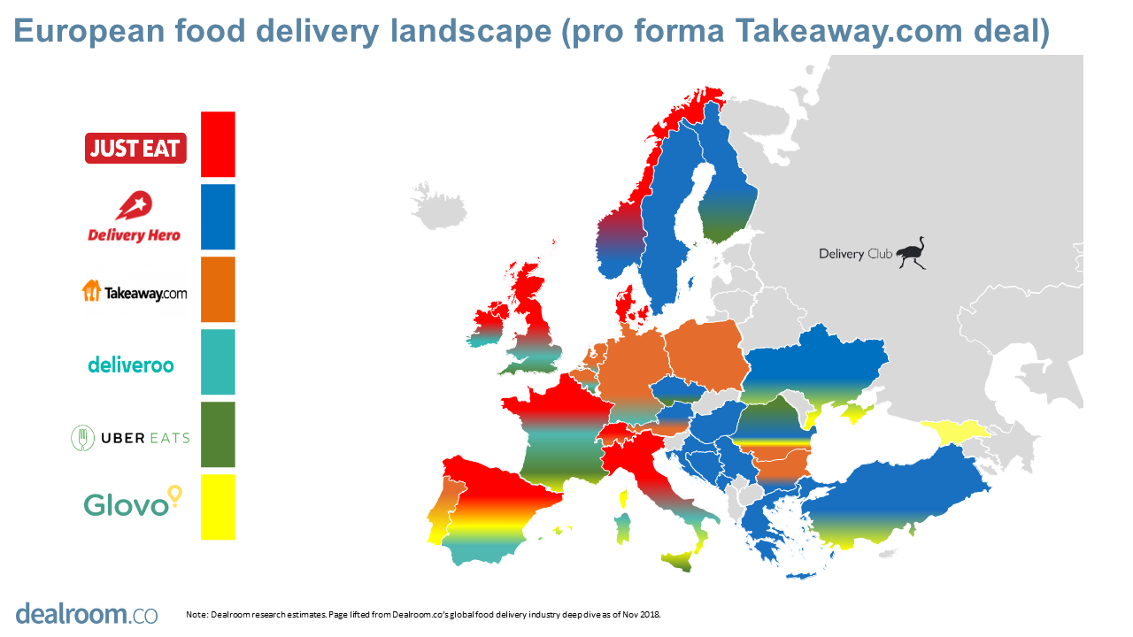
“Local” network externalities [Koski and Kretschmer 2008] or within-country (e.g. food delivery) network externalities [Stallkamp and Schotter (2019), Global Strategy Journal].

Slide 22
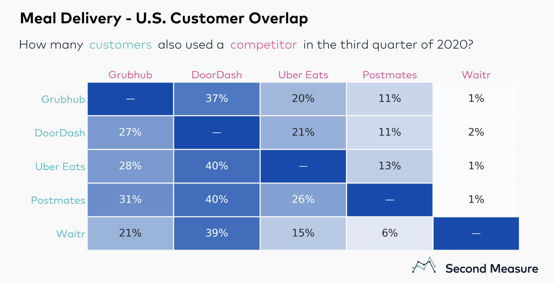
Of course, these 3 reasons may co-exist (and reinforce)
Fewer customers are loyal to a single meal delivery service
Despite overall industry growth, the battle for customers is getting more intense because fewer of today’s diners are loyal to just one service. (Grubhub’s former CEO cited “promiscuous customers” as a hindrance to his company’s growth.) […] more diners are going to have to hop between apps to cover all their favorite takeout spots and find the best deals. The least loyal customers, it seems, will also be the most well fed.
(From “Which company is winning the restaurant food delivery war?” By Janine Perri – Second Measure Bloomberg — 14 Apr 2023)

Slide 23
ESSENTIAL REFERENCES
(for this and upcoming lectures on network economics)
L. Cabral, Introduction to Industrial organization, I edition, 2000, Chapter 16.
J. H. Rohlfs, 2003, Bandwagon effects in high-technology industries, MIT, Boston, Chapters 3,4,5.
Additional:
C. Shapiro e H. R. Varian, 1999, Information rules, ETAS Libri
Peter Grindley, 1995, Standards, Strategy, and Policy,Cases and Stories, Oxford University Press.
L. Cabral, Introduction to Industrial organization, II edition, 2018, Chapter 16.

Slide 24
Appendix 1 Critical mass in sociology
Adapted example from Schelling (1978):
Micromotives and Macrobehaviour

Slide 25
Background
Suppose a University Professor is particularly nasty and decide to schedule a series of seminars on Saturday afternoon. Attendance by students is not strictly mandatory, but of course «being there» (or not being there) may favorably (or negatively) impress the Professor (suppose the exam is oral).
Knowing all that, each student will decide whether to participate or not on the basis of a minimum threshold of attendance to these seminars by the class. Students’ expectations are adaptive over time (i.e. what students expect in terms of seminars’ participation in the present week will strictly depend on the actual attendance registered in the previous week). Needless to say, there is no possibilities for coordination among students.
The class is composed by 10 students. Students are heterogeneous and they have different minimum thresholds.
More specifically, let us assume that these thresholds exhibit a distribution close to the normal Gaussian distribution. In particular, for 1 student the minimum threshold is equal to 2 students; 1 student has 3 as minimum threshold; 2 students have 4; 2 students have 5; 3 students have 6; and lastly, 1 student has a minimum threshold of 8.

Slide 26
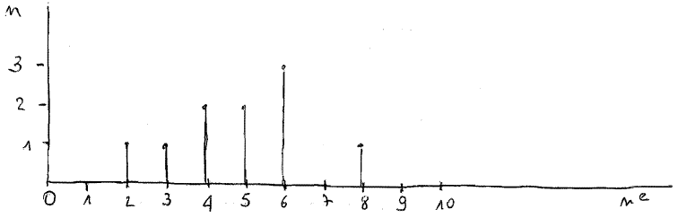
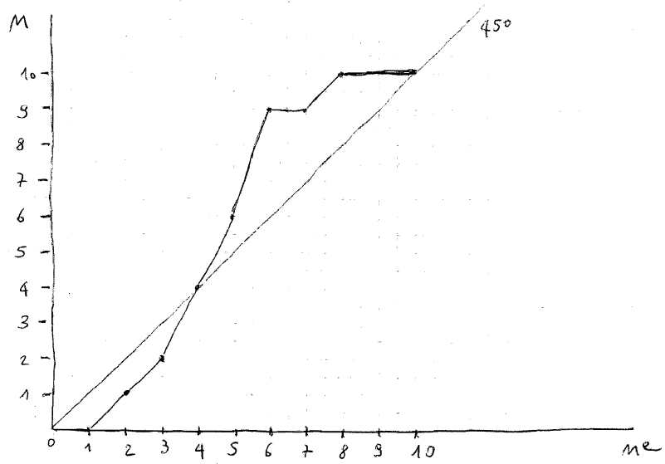
Frequency distribution of minimum thresholds
Cumulative function

Slide 27
Analysis
4 students represents the critical mass for this cycle of seminars : 4 students are willing to participate only if the participants to the seminars amount to 4 students.
This is an equilibrium. But is it stable? Let’s try to perturb it.
Let us suppose that at the first seminar instead of 4, 5 is the number of attendees. The following week (as you can see from the graphs of the previous slides), the number of students who will attend the seminars will be equal to 6; the Saturday of the 3° week, students will become 9, and at the Saturday of the 4° week, every student will attend the seminar.
Let us suppose that instead of 4, 3 is the number of attendees. The following week (as you can see from the graphs of the previous slides), the number of students who will attend the seminars will be equal to 2; on the Saturday of the 3° week only one student will attend, starting from the Saturday of the 4° week, every student will not attend the seminar.
The tipping point between success and failure is represented by the achievement of the critical mass.

Slide 28
APPENDIX 2
Network goods
Diffusion path examples

Slide 29

Some examples
1) Video-telephone: network failure in U.S. in ’70 and Italy in ‘80
Launched in the early 70s by AT&T in the Chicago area.
Price not too high (86 $ flat monthly rate)
Service quality not too bad
Major failure causes:
Privacy
Rate of return regulation (cost-plus scheme)
If something new is technically feasible does not necessarily mean that will be appreciated by consumers (invention does not imply innovation)
Low incentives to invest in marketing and related expenditure to reach the critical mass.

Slide 30
2) Fax
-1843 invented by Bain
-1865 commercial fax service between Paris and Lyons
-1925 AT&T commercialize the fax in U.S.
-1982/1990 rapid growth (c.a. 80% penetration rate among offices)
Source: Cabral, 2000,
Industrial Organization

Slide 31
3) Telephone (invented in 1870s)
US President Rutherford Hayes «It's a great invention, but who would ever want to use one?».
One to one
Vs. Network nature
Exploitation of patents in the short-term, i.e. high prices. Rent of the equipment: $14/month (equivalent to $330 in 2000s) vs. production cost: $4
[See Rohlfs 2003]
Source: Riordan, 2001, Handbook of Telecommunications Economics

Slide 32
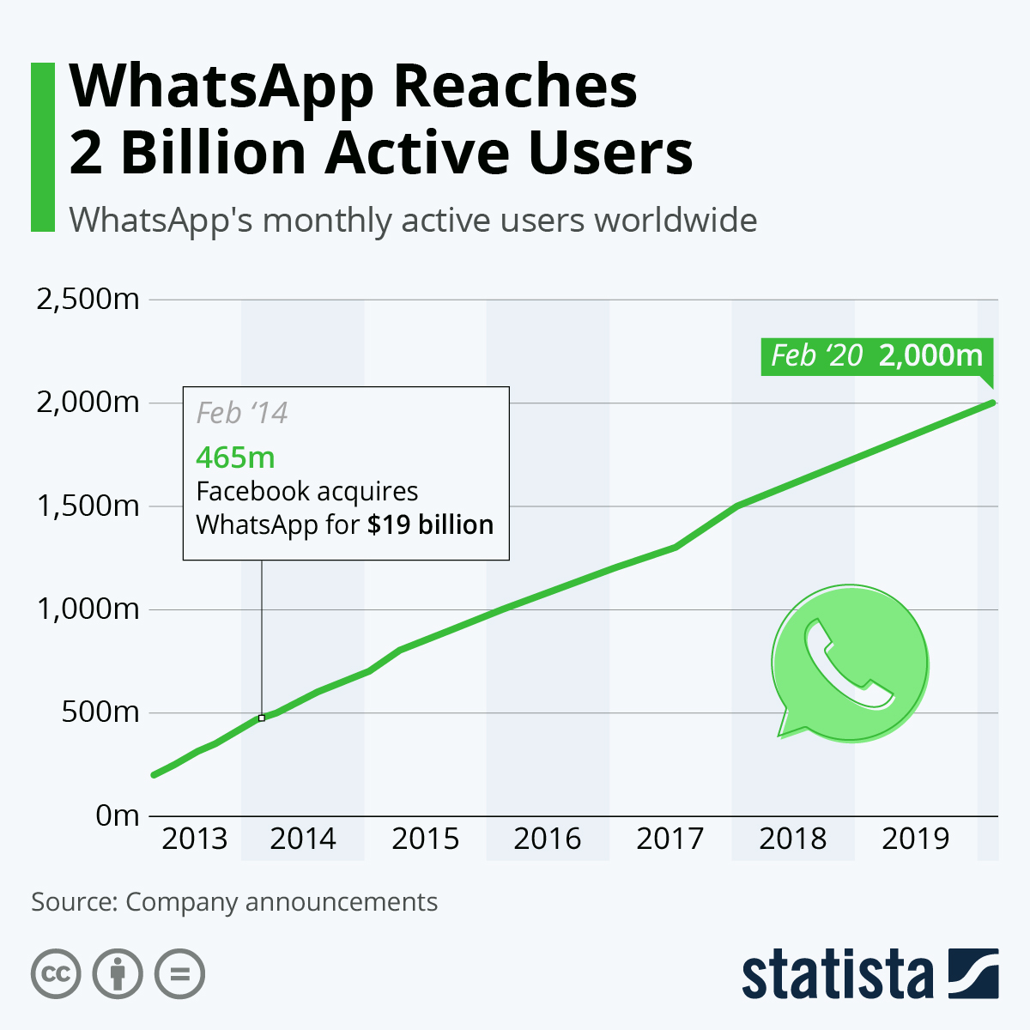
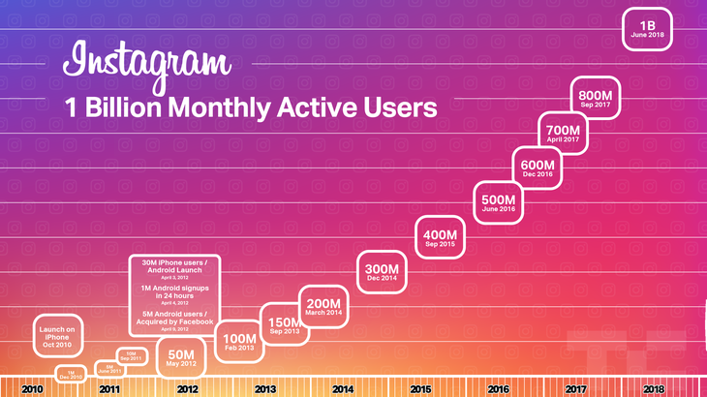
4) Social media: Whatsapp & Instagram

Slide 33
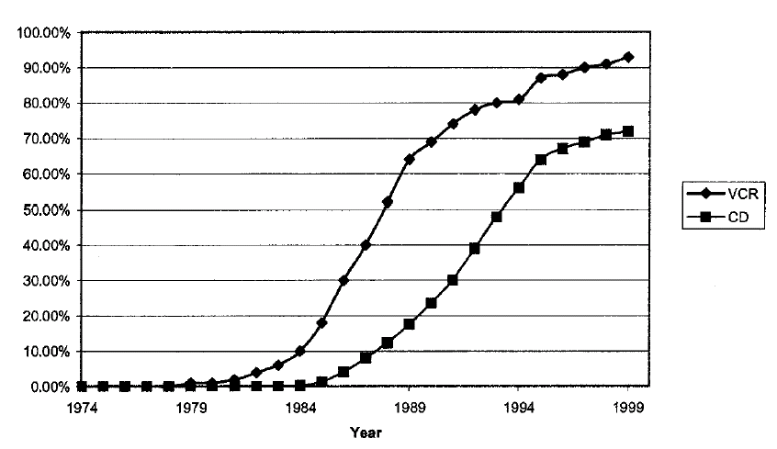
5) VCR and CD (U.S.)
Source: Dranove and Gandal, 2003, JEMS

